Slide 1

FORMs in HTML
<form>

Slide 2
7.1 About Forms
Forms can contain;
  Text boxes
  Password boxes
  Check boxes
  Radio buttons
  Buttons
  Select lists
  Text areas
  Labels – is normal text by using it you can select the form element

Slide 3
7.2 Form Elements
All form elements should be written in between the <form>..</form> tags.
Tag | Description
<form> | Defines an HTML form for user input
<input> | Defines an input control
<label> | Defines a label for an <input> element
<textarea> | Defines a multiline input
<select> | Defines a drop-down list
<option> | Defines an option in a drop-down list
<legend> | Defines a caption for a <fieldset> element
<button> | Defines a clickable button

Slide 4
7.2 Form Elements - <input>
The most important form element is the input element.
An input element can vary in many ways, depending on the type attribute.
An input element can be of type
  text,
  checkbox,
  password,
  radio,
  submit,
  reset

Slide 5
7.2 Form Elements - <input>
INPUT element Attributes:
TYPE (required)
  Defines the usage of the INPUT element.
NAME provides a unique identification for INPUT element.
  Each input field must have a name attribute to be submitted.
VALUE indicates the value that the INPUT element sends to the server upon submission.
SIZE attribute specifies the size for the input field. (in characters)
MAXLENGTH attribute specifies the maximum number of characters that the input field will accept.

Slide 6
7.2 Form Elements - <input>
INPUT element Attributes:
The READONLY attribute specifies that the input field is read only (cannot be changed)
  <input type="text" name="firstname" value="Raygan" readonly>
The DISABLED attribute specifies that the input field is disabled.
  A disabled input field is unusable and un-clickable, and its value will not be sent when submitting the form
  <input type="text" name="firstname" value="Raygan" disabled>
http://staff.emu.edu.tr/raygankansoy/en/teaching/itec229

Slide 7

7.2 Form Elements - <input>
Radio Buttons
Usually found in a group of options, only one radio button in a group can be selected at a time.
Selecting one radio button deselects the others in its group.
Each radio button within a group should have the same name and different values. (Otherwise, browsers cannot distinguish between them)
CHECKED attribute indicates which radio button is selected initially
Example
<input type="radio" name="gender" value="male"> Male<br> <input type="radio" name="gender" value="female" checked>Female<br>
Result

Slide 8

7.2 Form Elements - <input>
Check Boxes
Check boxes let a user select NONE/ONE/MORE options of a limited number of choices.
Each check box within a group should have the same name and different values. (Otherwise, browsers cannot distinguish between them)
CHECKED attribute indicates initially selected checkboxe/s.
Example
<input type="checkbox" name="choice" value="cb1" checked>Love <br> <input type="checkbox" name="choice" value="cb2">Cash <br> <input type="checkbox" name="choice" value="cb3" checked>Education <br>
Result

Slide 9
7.2 Form Elements - <input>
Submit Button
<input type="submit"> defines a submit button.
A submit button is used to send form data to a server.
The data is sent to the page specified in the form's action attribute.

Slide 10
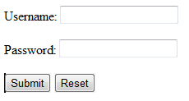
7.2 Form Elements - <input>
Reset Button
A reset button is used to clear all the entries user entered into the form and reset the form-data to its default values.
VALUE attribute changes the text displayed on the button (default is “Reset”)
Example
<form name="input" action="html_form_action.asp" method="get"> <P>Username: <input type="text" name="user" size="25"></P> <P>Password: <input type="password" name="pswd" size="25"></P> <P><input type="submit" value="Submit"> <input type="reset" value="Reset"></P></form>
Result

Slide 11
7.2 Form Elements - <label>
Label
The <label> tag defines a label for an <input> element.
The <label> element does not render as anything special for the user. However, it provides a usability improvement for mouse users, because if the user clicks on the text within the <label> element, it toggles the control.
The for attribute of the <label> tag should be equal to the id attribute of the related element to bind them together.
A label can be bound to an element either by using the "for" attribute, or by placing the element inside the <label> element.

Slide 12

7.2 Form Elements - <label>
Label
Example
<input type="radio" name="gender" id="male" value="male" checked> <label for="male">Male</label><br> <input type="radio" name="gender" id="female" value="female"> <label for="female">Female</label><br> <input type="radio" name="gender" id="other" value="other"> <label for="other">Other</label><br>
Result

Slide 13
7.2 Form Elements - <select>,<option>
List Box
<select> tag presents a drop-down list with choices indicated by the <option> tags
  Include NAME attribute
By default, the first item in the drop-down list is selected.
To define a pre-selected option, add the selected attribute to the option
Change the number of list options visible by including the SIZE = “x” attribute inside the <SELECT> tag
  x number of options visible
Use the multiple attribute to allow the user to select more than one value:
  if you use multiple attribute, you should also assign different values for each of the value attributes of option tags

Slide 14

7.2 Form Elements - <select>,<option>
List Box
Example
<select name="cars"> <option selected>BMW</option> <option>Mercedes</option> <option>Audi</option> </select>
Result

Slide 15
7.2 Form Elements
Example
<!DOCTYPE html> <!-- Form using a variety of components. --> <html> <head> <meta charset = "utf-8"> <title>Form Example-1</title> </head> <body> <h1>Feedback Form</h1> <p>Please fill out this form to help us improve our site.</p> <form method = "post" action = ""> <p><label><strong>Name:</strong> <input name = "name" type = "text" size = "25"> </label></p> <p><label><strong>Comments:</strong><br> <textarea name = "comments" rows = "4" cols = "36"></textarea> </label></p> <p><label><strong>E-mail Address:</strong> <input name = "email" type = "email" size = "25"> </label></p>

Slide 16
7.2 Form Elements
Example (cont..)
<p><strong>Things you liked:</strong><br> <label>Site design <input name = "thingsliked" type = "checkbox" value = "Design"></label> <label>Links <input name = "thingsliked" type = "checkbox" value = "Links"></label> <label>Ease of use <input name = "thingsliked" type = "checkbox" value = "Ease"></label> <label>Images <input name = "thingsliked" type = "checkbox" value = "Images"></label> <label>Source code <input name = "thingsliked" type = "checkbox" value = "Code"></label> </p> <p><strong>How did you get to our site?:</strong><br> <label>Search engine <input name = "howtosite" type = "radio" value = "search engine" checked></label> <label>Links from another site <input name = "howtosite" type = "radio" value = "link"></label> <label>Reference in a book <input name = "howtosite" type = "radio" value = "book"></label> <label>Other <input name = "howtosite" type = "radio" value = "other"></label> </p>

Slide 17
7.2 Form Elements
Example (cont..)
<p> <b>Rate our site:<b> <select name = "rating"> <option selected>10</option> <option>9</option> <option>8</option> <option>7</option> <option>6</option> <option>5</option> <option>4</option> <option>3</option> <option>2</option> <option>1</option> </select> </p> <p> <input type = "submit" value = "Submit"> <input type = "reset" value = "Clear"> </p> </form> </body> </html>

Slide 18
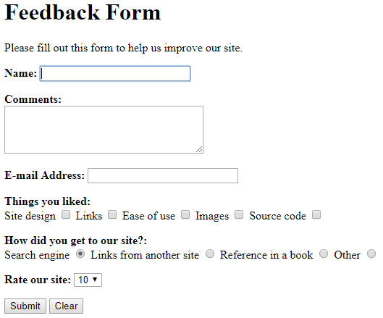
7.2 Form Elements
Output

Slide 19
7.3 HTML5 Input Types
HTML5 added several new input types:
  color
  date
  datetime-local
  email
  month
  number
  range
  search
  tel
  time
  url
  week

Slide 20
7.3 HTML5 Input Types - color
Is used for input fields that should contain a color.
The color tool allows the user to choose a color using standard web formats.
Depending on browser support, a color-picker can show up in the input field like the ones

Slide 21

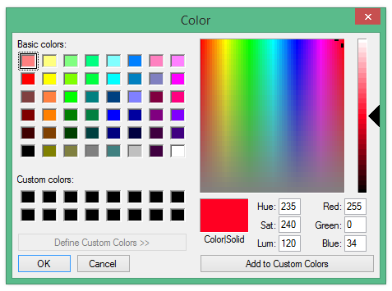
7.3 HTML5 Input Types - color
Example
Select your favorite color: <input type="color" name="favcolor" value="#ff0022">
Result

Slide 22
7.3 HTML5 Input Types - date
Setting the input type to date indicates that you wish the user to enter a date.
Depending on browser support, a date picker can show up in the input field.
You can restrict the dates allowed to a specific range by applying the min and max attributes to the element.

Slide 23
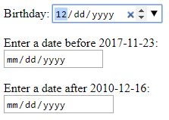
7.3 HTML5 Input Types - date
Example
Birthday: <input type="date" name="bday"><br><br> Enter a date before 2017-11-23:<br> <input type="date" name="bday" max="2017-11-22"><br><br> Enter a date after 2010-12-16:<br> <input type="date" name="bday" min="2010-12-17"><br><br>
Result

Slide 24

7.3 HTML5 Input Types - time
The purpose of the time input type is to allow the user to enter a time.
Depending on browser support a time picker might pop-up when you enter the input field.
Example
Select a time: <input type="time" name="times">
Result

Slide 25

7.3 HTML5 Input Types - month
Allows the user to select a month and year.
Depending on browser support, a date picker can show up in the input field.
Example
Birthday (month and year): <input type="month" name="bdaymonth">
Result

Slide 26

7.3 HTML5 Input Types – email
Used for input fields that should contain an e-mail address.
Depending on browser support, the e-mail address can be automatically validated when submitted.
Example
E-mail: <input type="email" name="mail">
Result

Slide 27

7.3 HTML5 Input Types - range
Defines a control for entering a number whose exact value is not important.
Default range is 0 to 100. However, you can set restrictions on what numbers are accepted with the min and max attributes.
Depending on browser support, the input type "range" can be displayed as a slider control.
Example
Grade: <input type="range" name="points" min="0" max="100">
Result

